Slide 1

RT-HDIST: Ray-Tracing Core-based Hausdorff Distance Computation
YoungWoo Kim, Jaehong Lee, Duksu Kim
KOREATECH
Republic of Korea

Slide 2

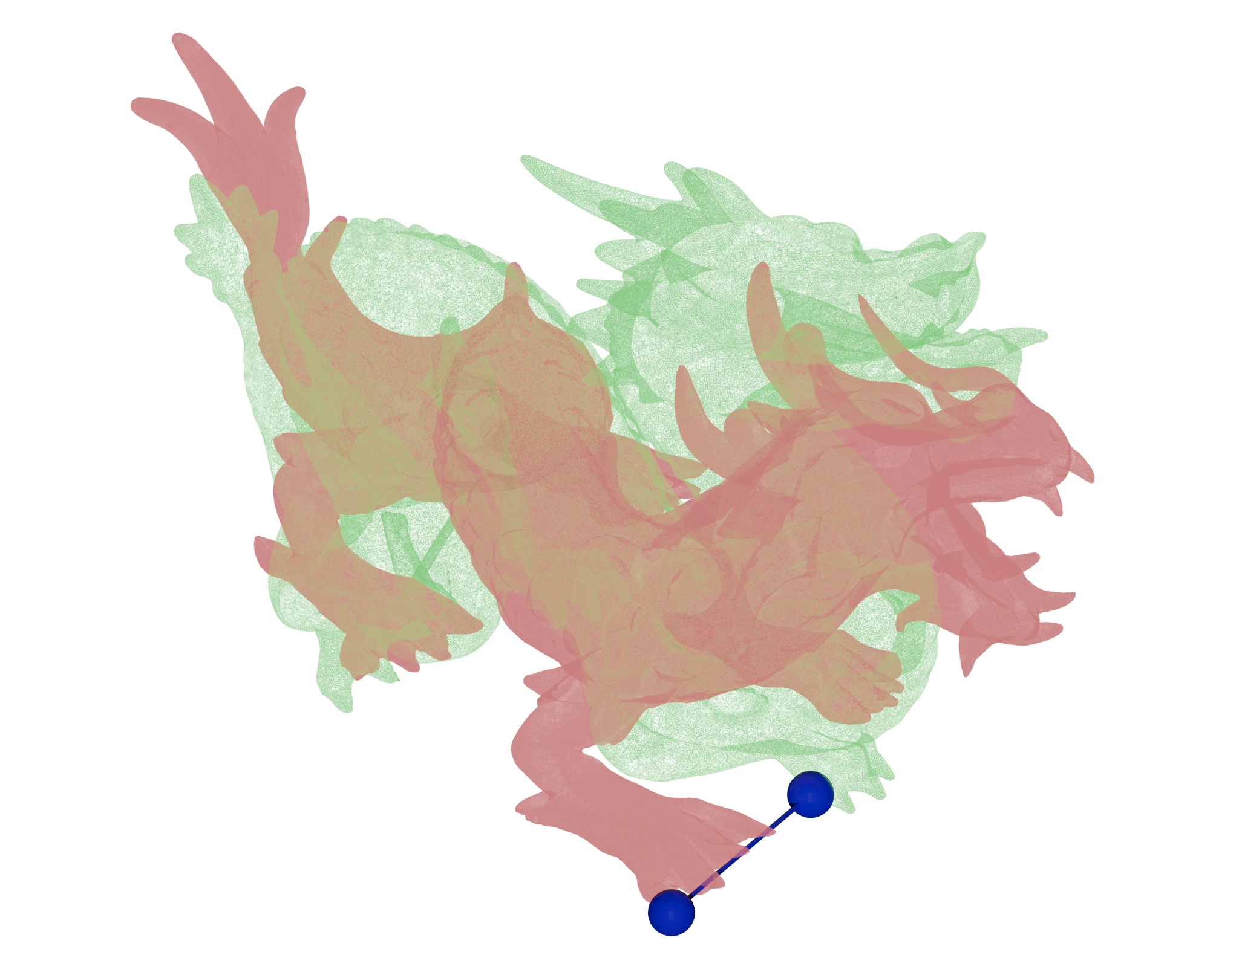
Hausdorff distance
Measures how far two subsets of a metric space are from each other
$$H\left(A,B\right)=max(\max_{a∈A}{\min_{b∈B}{d\left(a,b\right)},\max_{b∈B}{\min_{a∈A}{d\left(a,b\right)})}}$$

Slide 3
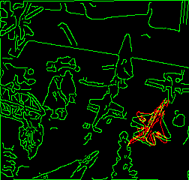
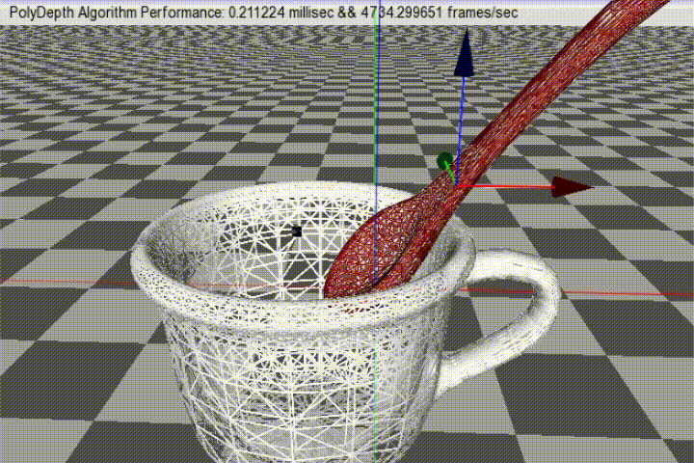
Hausdorff distance in App.
Hausdorff distance is used for various applications
Such as Computer Graphics, Computer Vision, Robotics
Similarity check
Pattern matching
Simulation
Compare the object similarity between two- or more- objects
Finding position or registration, etc…
Penetration depth calculation
[Image from Normand et al.]
PolyDepth
[Je et al., 2012]

Slide 4
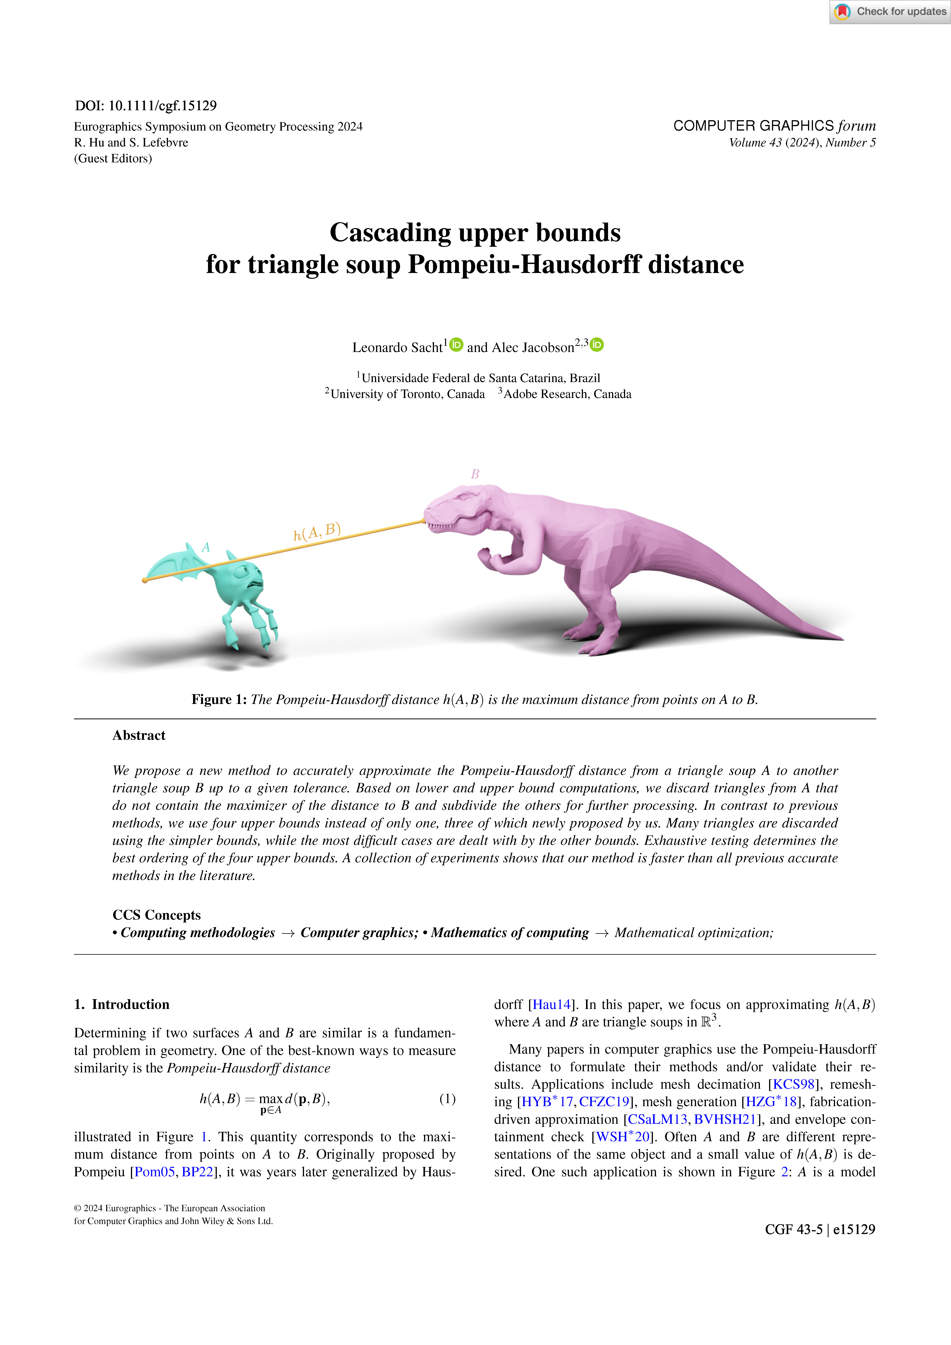
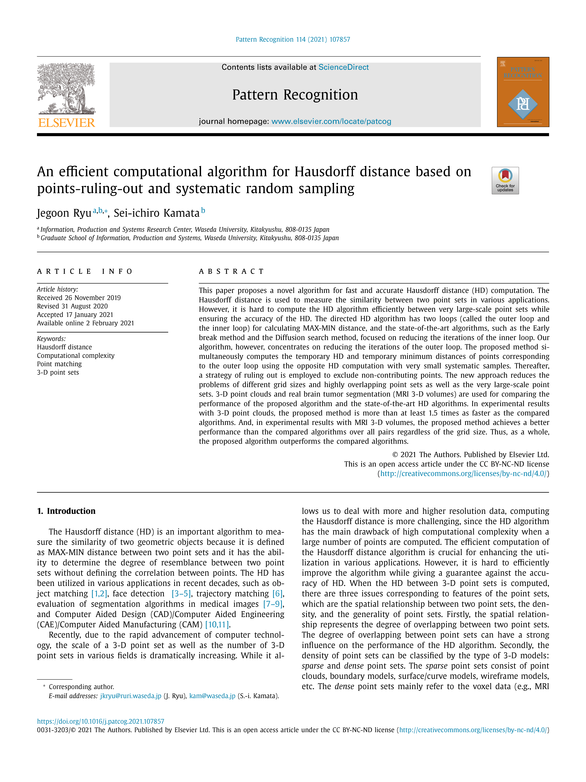
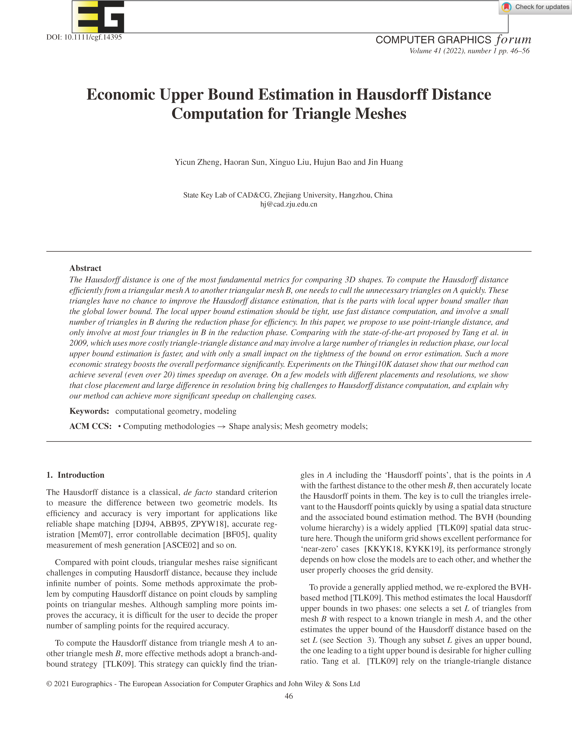
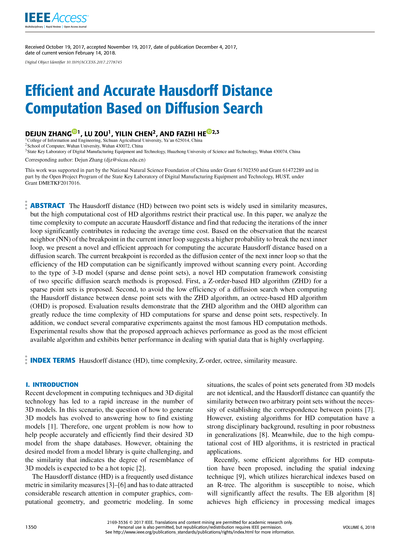
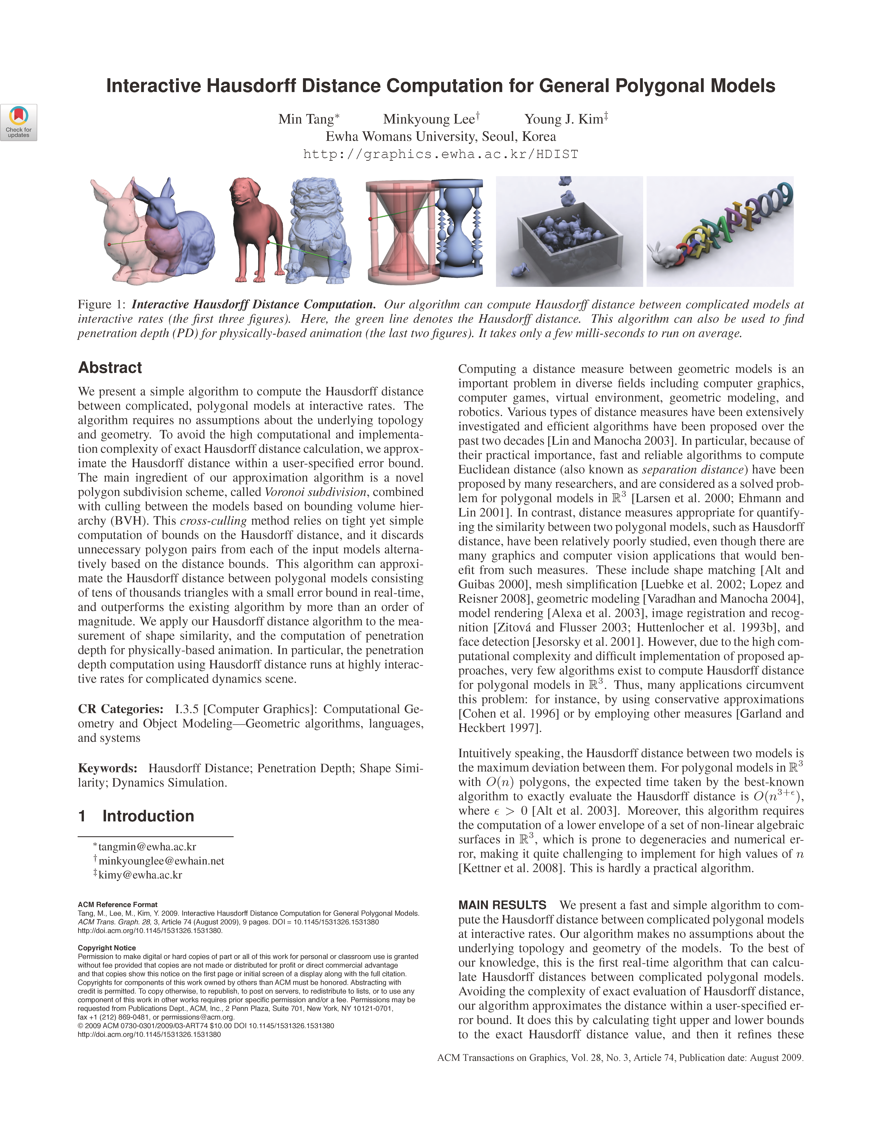
Related work
[Sacht et al., 2024]
[Ryu et al., 2021]
[Zheng et al., 2022]
[Zhang et al., 2017]
[Tang et al., 2009]
Point-based Hausdorff
Object-based Hausdorff

Slide 5
Related work
culled
Acceleration Hierarchies
Lower- and Upper- bound culling

Slide 6
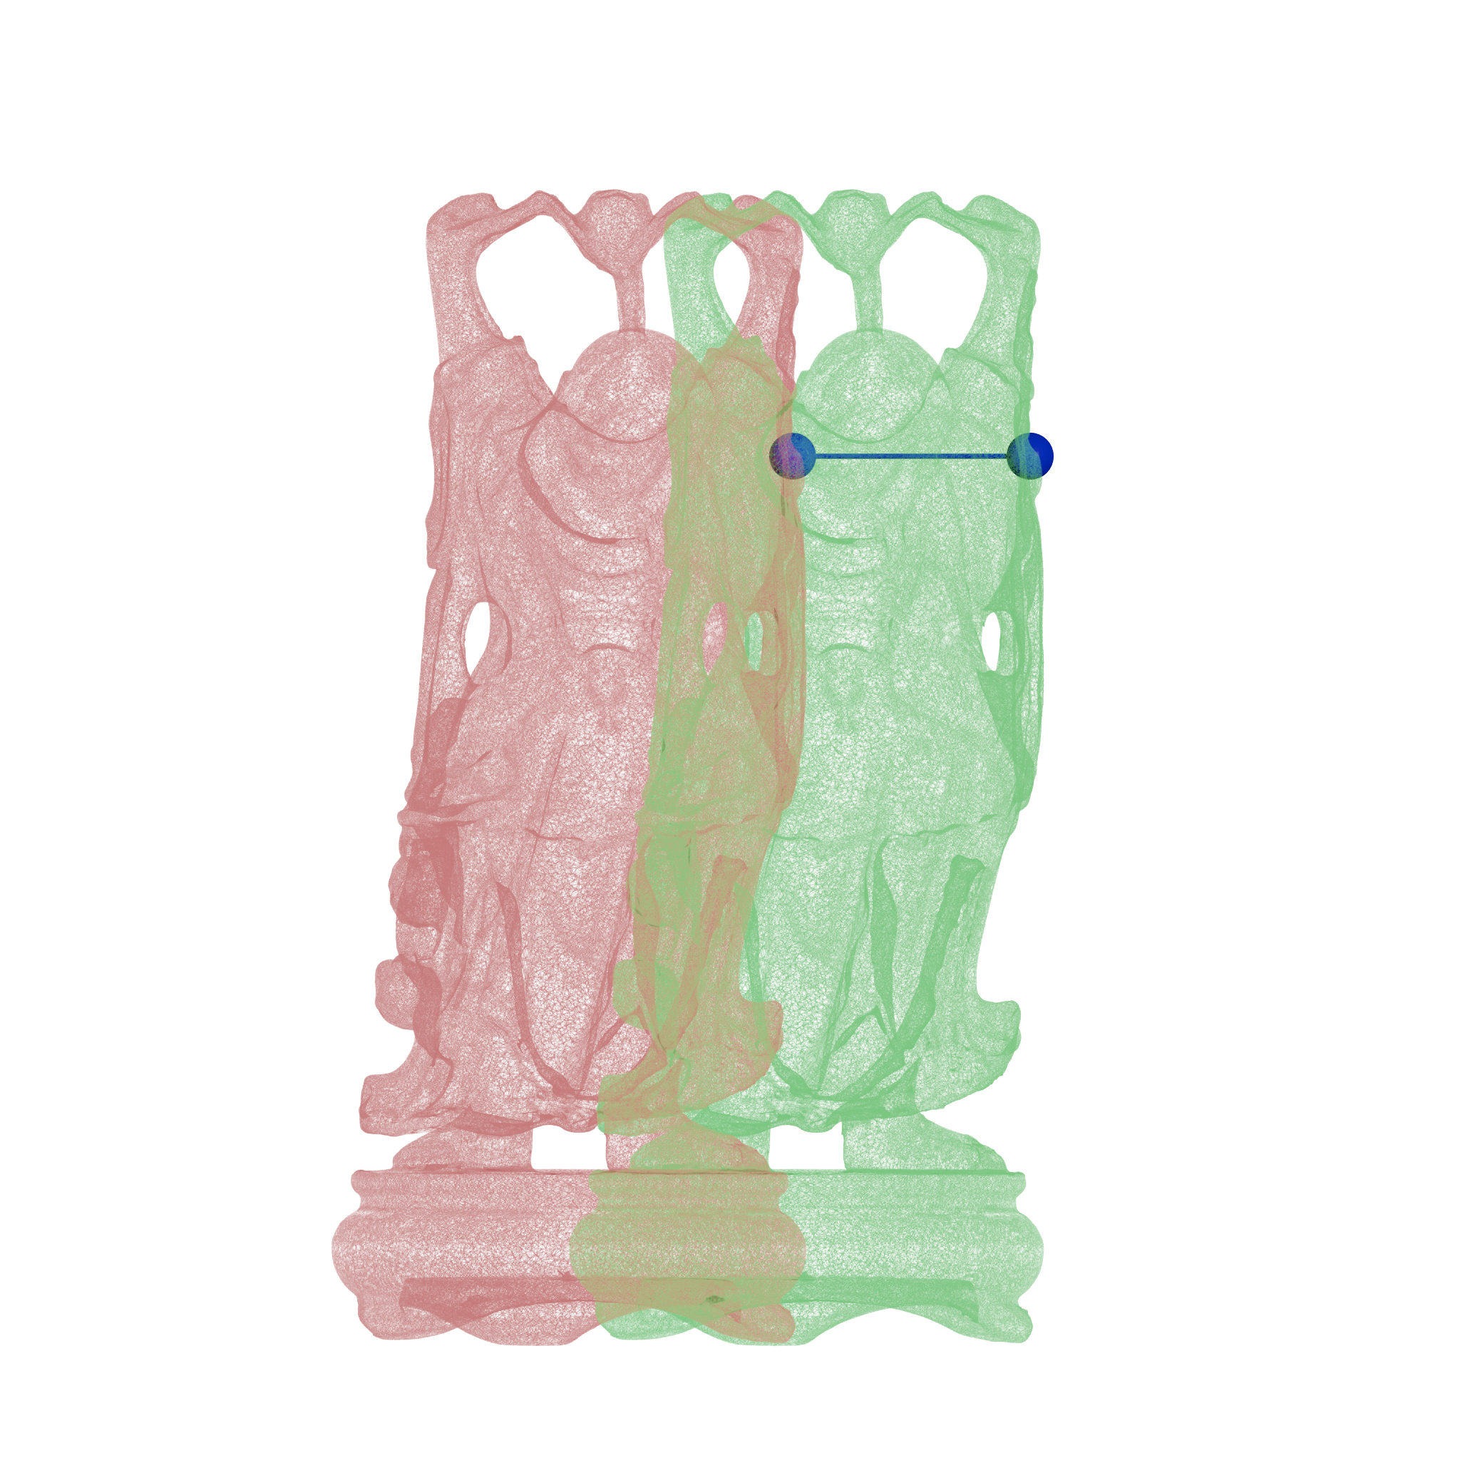
Problem
Low parallelism
CPU only method
Low performance for large data
Happy Budda (543K points)

Slide 7
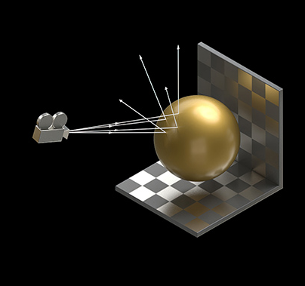
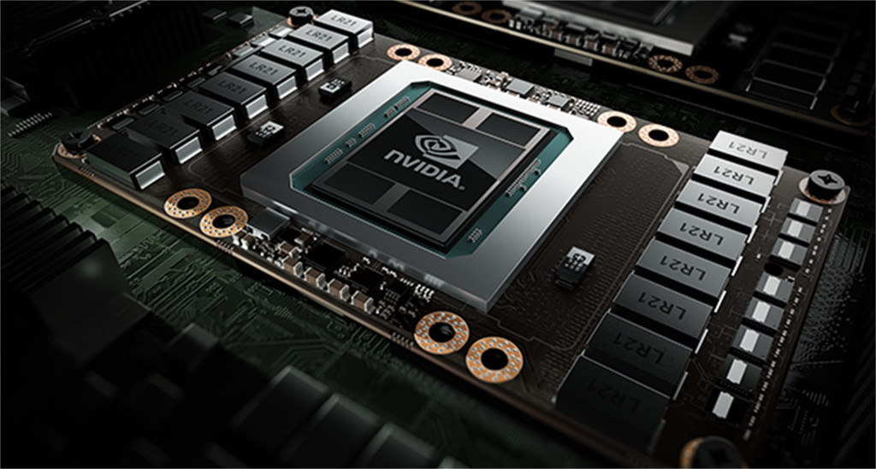
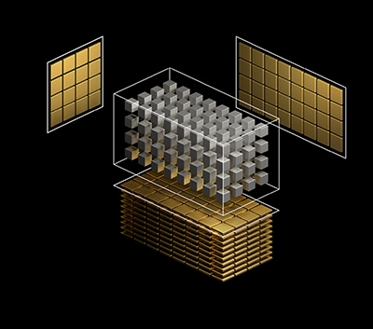
Modern GPU system
Modern GPU system employs specialized hardware units
Ray tracing core
Tensor core
[image from NVIDA blog]

Slide 8
Ray tracing Hardware
The ray tracing core accelerates the intersection test between the ray and the acceleration hierarchy
Ray tracing core
Ray-AH traversal
Ray-Primitive intersection
Accelerate tree traversal via ray tracing formulation

Slide 9
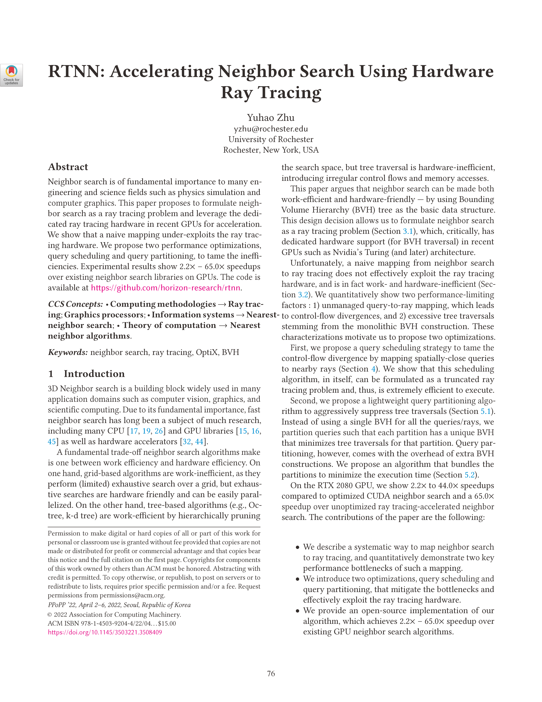
Problem
How to transform the Hausdorff distance computation into a ray tracing problem?
We adapt the RTNN [Zhu, 2022] approach that proposed the method utilizing the ray tracing core to compute the nearest neighbor
[Zhu, 2022]

Slide 10


RTNN approach
$ε$-NN based neighbor search with ray-tracing core
$$r$$

Slide 11

RTNN approach
$ε$-NN based neighbor search with ray-tracing core
AABB
Short ray
$$r$$

Slide 12

RTNN approach
$ε$-NN based neighbor search with ray-tracing core
$$r$$
$$r$$

Slide 13
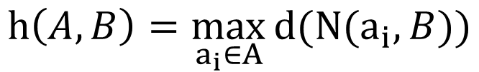
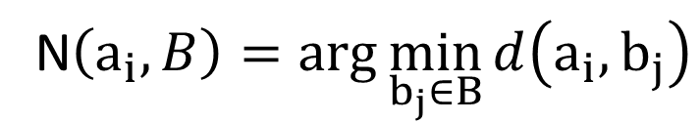
Hausdorff distance with NN
Hausdorff distance
$$H\left(A,B\right)=max(\max_{a∈A}{\min_{b∈B}{d\left(a,b\right)},\max_{b∈B}{\min_{a∈A}{d\left(a,b\right)})}}$$
Nearest neighbor
N$\left(a_{i},B\right)=\arg_{}{\min_{b_{j}∈B}{d\left(a_{i},b_{j}\right)}}$
Hausdorff distance with NN
$$h\left(A,B\right)=\max_{a_{i}∈A}{d(N(a_{i},B))}$$

Slide 14
Algorithm overview
Our method computes the Hausdorff distance between point sets with a 3-step approach
​ | ​ | ​
​ | ​ | ​
​ | ​ | ​
​ | ​ | ​
​ | ​ | ​
​ | ​ | ​
​ | ​ | ​
​ | ​ | ​
​ | ​ | ​
​ | ​ | ​
​ | ​ | ​
​ | ​ | ​
​ | ​ | ​
​ | ​ | ​
​ | ​ | ​
1st
H( , )
2nd
Voxel-based clustering
Iterative candidate search
Refined distance computation

Slide 15
Voxel-based clustering
To reduce the redundant of intersection, we use the voxel-based clustering
AABB per query point
3 ray
3 intersection
3 distance computation
AABB per target point
1 ray
3 intersection
3 distance computation
AABB per cluster
1 ray
1 intersection
3 distance computation

Slide 16
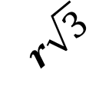

Voxel-based clustering
How can we select the AABB size?
​ | ​ | ​
​ | ​ | ​
​ | ​ | ​
​ | ​ | ​
​ | ​ | ​
​ | ​ | ​
​ | ​ | ​
​ | ​ | ​
​ | ​ | ​
$$r$$
1
$$r\sqrt{3}$$
1

Slide 17

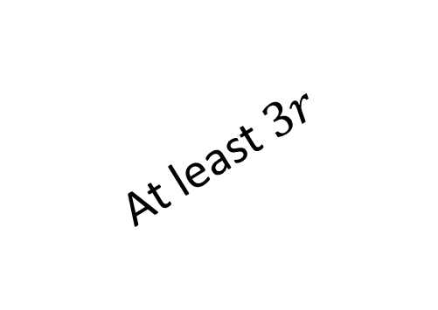
Iterative Candidate Search
Our goal is to find Hausdorff candidate
However, we don`t know a suitable AABB size for every query
1st
 | ​ | ​ | ​
 | ​ | ​ | ​
 | ​ | ​ | ​
 | ​ | ​ | ​
 | ​ | ​ | ​
 | ​ | ​ | ​
$$r$$
At least $3r$
$$d( , )≤r≤d( , )$$

Slide 18
Iterative Candidate Search
Our goal is finding Hausdorff candidate
However, we don`t know a suitable AABB size for every query
2nd
 | ​ | ​ | ​
 | ​ | ​ | ​
 | ​ | ​ | ​
 | ​ | ​ | ​
 | ​ | ​ | ​
 | ​ | ​ | ​
$$r$$
At least $3r$

Slide 19
Iterative Candidate Search
Our goal is finding Hausdorff candidate
However, we don`t know a suitable AABB size for every query
n^{th}
 | ​ | ​ | ​
 | ​ | ​ | ​
 | ​ | ​ | ​
 | ​ | ​ | ​
 | ​ | ​ | ​
 | ​ | ​ | ​
$$r$$
At least $3r$

Slide 20

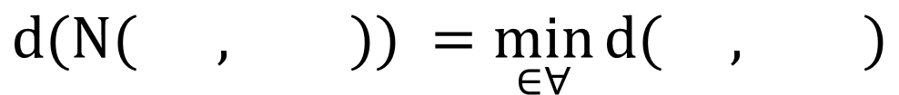
Refined distance computation
For all intersected candidates, compute the minimum distance
 | ​ | ​ | ​
 | ​ | ​ | ​
 | ​ | ​ | ​
$$d(N( , )) =\min_{∈∀}{d( , )}$$
$$h(A,B) = \max_{}{d(N( , ))}$$

Slide 21
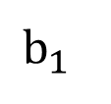
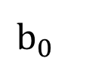
Error Handling
Need to consider voxel-based nearest distance error
$$b_{0}$$
 | ​ | ​ | ​
 | ​ | ​ | ​
 | ​ | ​ | ​
Search area
Query point
$$b_{1}$$
Cluster
Target point

Slide 22

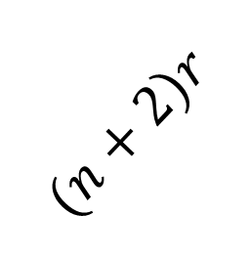

Error Handling
Need to consider voxel-based nearest distance error
Search area of n^{th} iteration
 | ​ | ​ | ​
 | ​ | ​ | ​
 | ​ | ​ | ​
 | ​ | ​ | ​
 | ​ | ​ | ​
 | ​ | ​ | ​
$$nr≤ ≤(n+2) r$$
$$(n+2)r$$
$$nr$$
Best case
Worst case

Slide 23

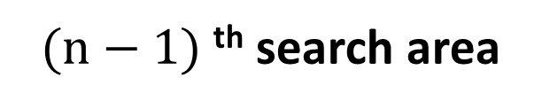

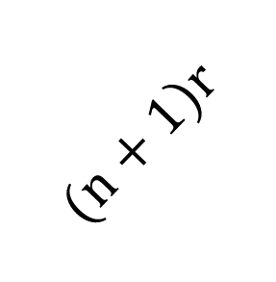
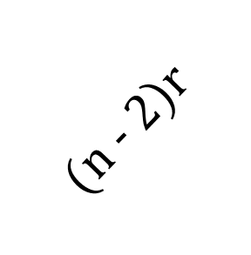
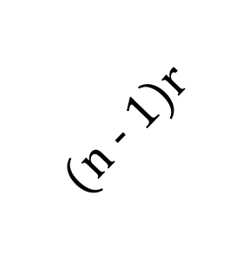
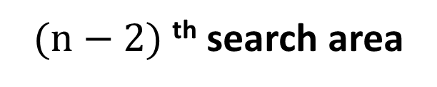

Error Handling
Need to consider voxel-based nearest distance error
Consideration of the worst case
 | ​ | ​ | ​
 | ​ | ​ | ​
 | ​ | ​ | ​
 | ​ | ​ | ​
 | ​ | ​ | ​
 | ​ | ​ | ​
 | ​ | ​ | ​
 | ​ | ​ | ​
 | ​ | ​ | ​
$$(n − 2)r$$
$$(n − 1)r$$
$$nr$$
$$(n+1)r$$
$$nr$$
$(n−2)$^{th} search area
$(n−1)$^{th} search area
$n$^{th} search area

Slide 24
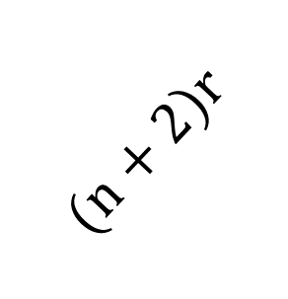
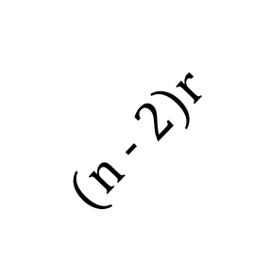


Error Handling
Need to consider voxel-based nearest distance error
Consideration of the worst case
 | ​ | ​ | ​
 | ​ | ​ | ​
 | ​ | ​ | ​
 | ​ | ​ | ​
 | ​ | ​ | ​
 | ​ | ​ | ​
 | ​ | ​ | ​
 | ​ | ​ | ​
 | ​ | ​ | ​
$$(n − 2)r≤ ≤(n+2) r$$
$$(n − 2)r$$
$$(n+2)r$$
By storing the 3 steps, we can cover the error
$n$^{th} search area

Slide 25

System environment
Host | Intel i5-14600K
RAM | 32GB
GPU | RTX 2080 | RTX 3080 | RTX 4080
Arch. | Turing | Ampere | Ada Lovelace
# of CUDA cores | 2,944 | 8,704 | 9,728
# of RT cores (Gen. ) | 46 (1st) | 68 (2nd) | 76 (3rd)

Slide 26
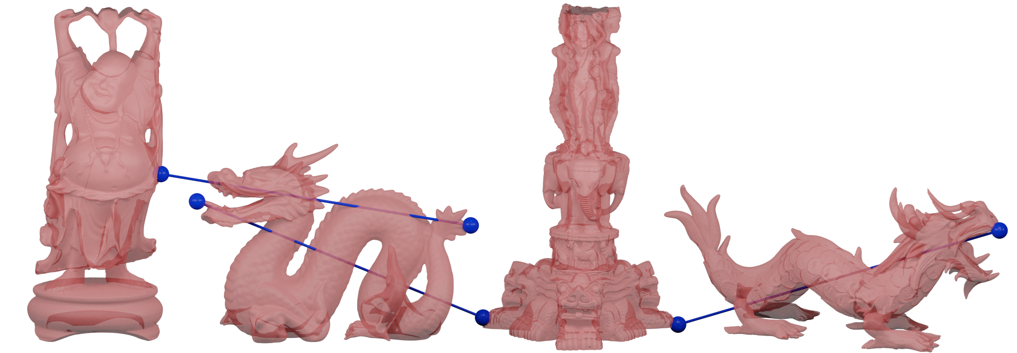
Benchmark model
Happy Buddha
(543K point)
Dragon
(437K point)
Thai statue
(4.9M point)
Asian Dragon
(3.6M point)

Slide 27
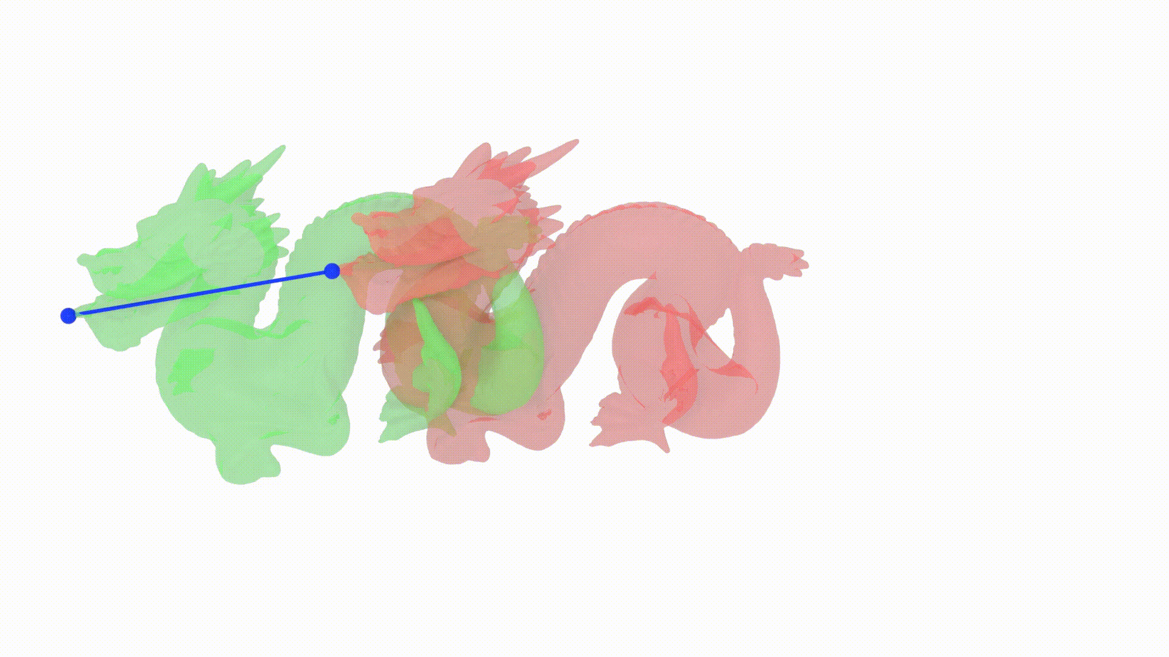
Scenario: Translation
16.7
x40.7
x1.5
0.41
0.27
Scenario: Translation
Dragon (437K points per object)

Slide 28
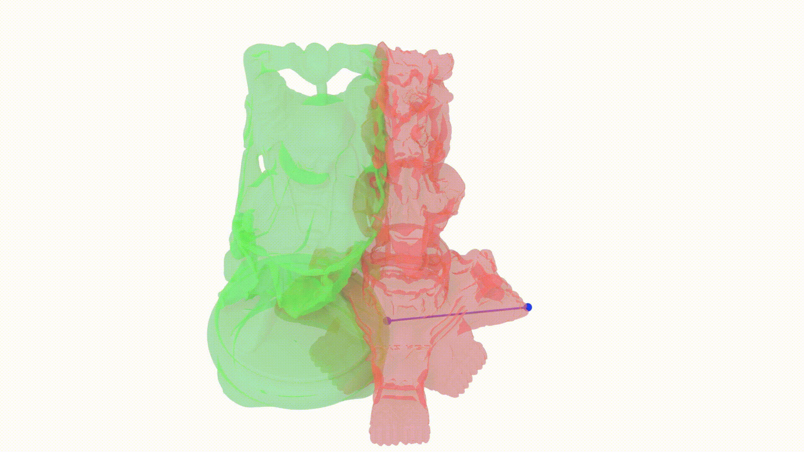
Scenario: Different object
x53.6
x1.5
3.22
0.06
Scenario: Different object
Thai Statue (4.8M) and Happy Budda (543K)
0.04

Slide 29
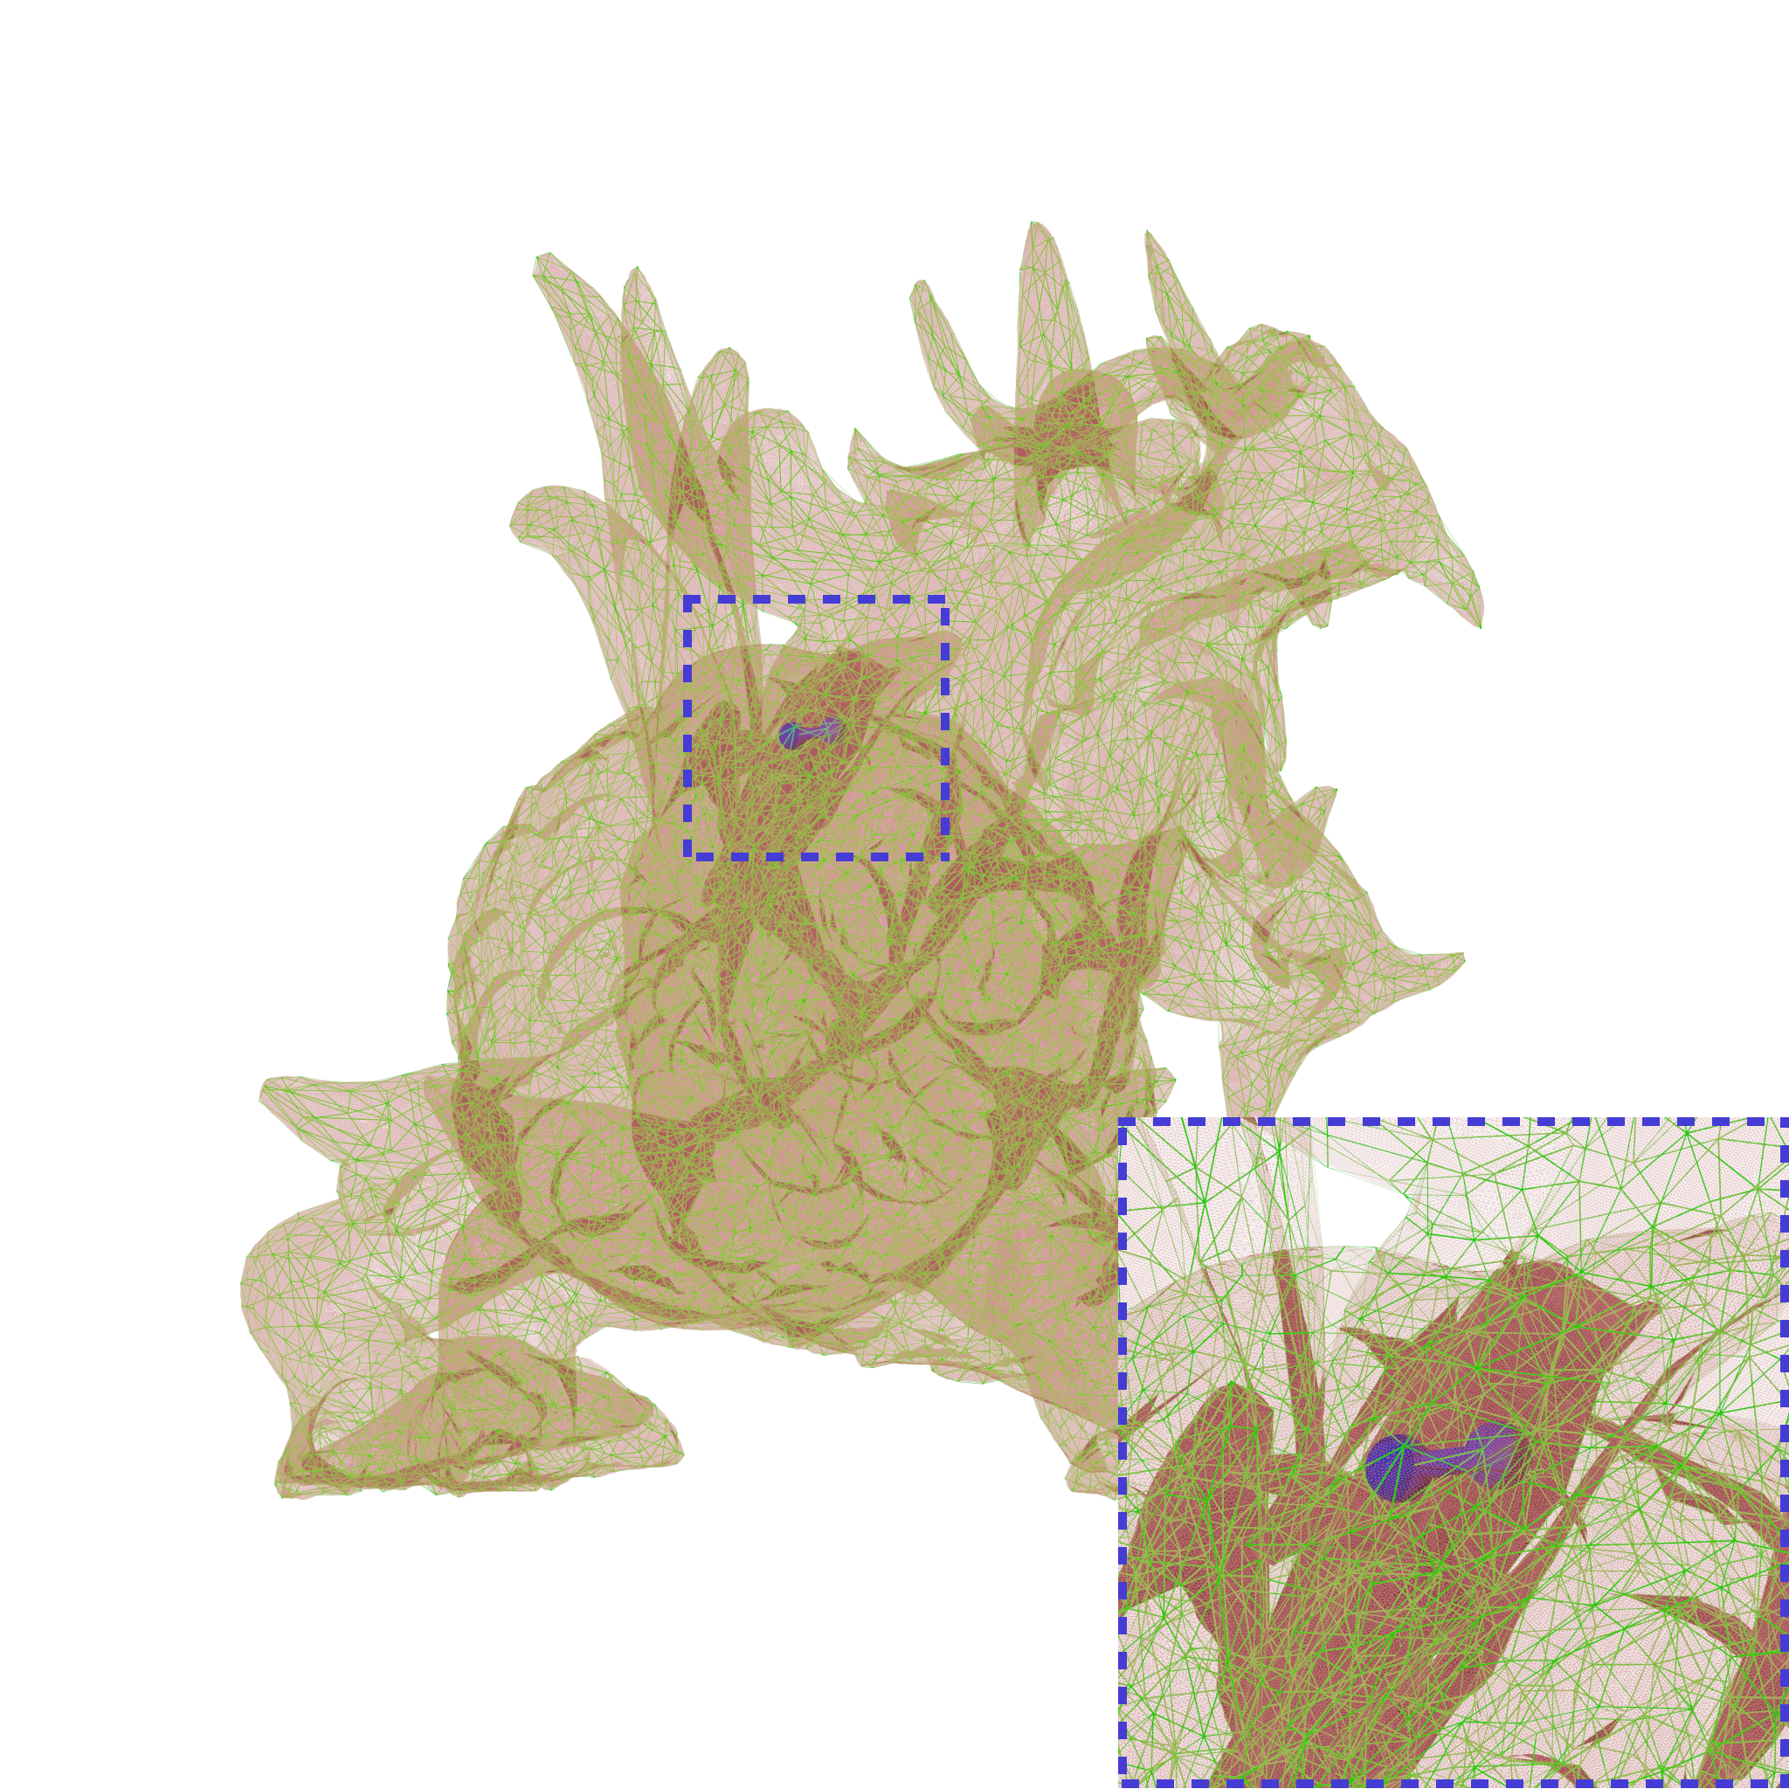
Scenario: Decimation
X90.91
x2.2
10
0.05
0.11
Scenario: Decimation
Asian Dragon (3.61M points and 10K points)

Slide 30
Conclusion
We proposed a novel method to solve Hausdorff distance between point sets using ray tracing core
X 120.97
X 63.24
X 33.39

Slide 31
Future work
Hyperparameter
Polygonal model-based Hausdorff distance

Slide 32



For more detail, please visit the project page
https://www.spinlab.kr/home
Thank you
https://hpc-lab-koreatech.github.io/RT-HDIST/

Slide 33
References
KD-Tree-based and Octree-based point-point Hausdorff distance
[Zhang et al. 2017] Efficient and accurate Hausdorff distance computation based on diffusion search
[Taha et al. 2015] An efficient algorithm for calculating the exact Hausdorff distance
[Ryu et al. 2021] An efficient computational algorithm for Hausdorff distance based on points-ruling-out and systematic random sampling
Recent researched for triangle-triangle Hausdorff distance
[Tang et al. 2009] Interactive Hausdorff distance computation for general polygonal models
[Zheng et al. 2022] Economic upper bound estimation in Hausdorff distance computation for triangle meshes
[Sacht et al. 2024] Cascading upper bounds for triangle soup Pompeiu-Hausdorff distance
Nearest neighbor with ray tracing core
[Zhu, 2022] RTNN: accelerating neighbor search using hardware ray tracing
[Nagarajan et al., 2023] RT-kNNS Unbound: Using RT Cores to Accelerate Unrestricted Neighbor Search
[Mandarapu et al., 2024] Arkade: k-Nearest Neighbor Search With Non-Euclidean Distances using GPU Ray Tracing

Slide 34

UP NEXT :
SESSION NAME

